Slide 1
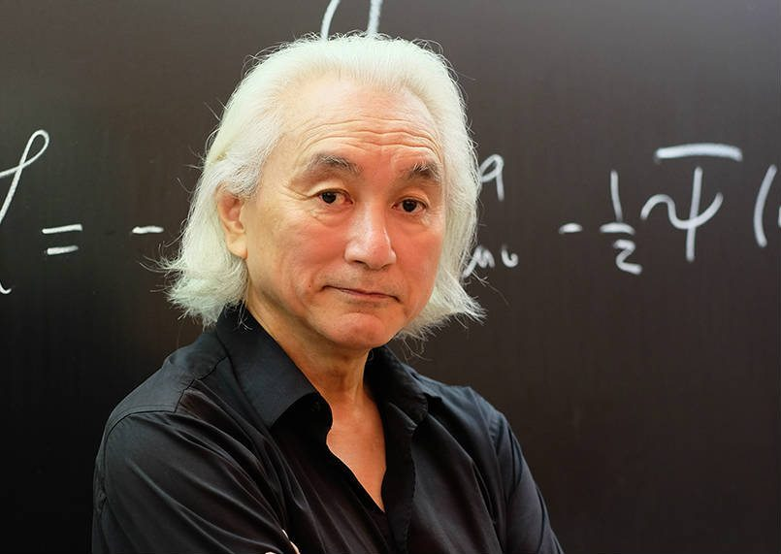
Michio Katu
Notes:
# Name Michio Katu # Textbook Knight, Physics for Scientists and Engineers: A Strategic Approach with Modern Physics, 3rd Edition, Chapter 28 # Contributors Yuyu Zhang # Description Professor Michio Kaku, born in 1947, is a theoretical physicist, futurist, and popularizer of science. He is one of the co-founder of string field theory, a branch of string theory, which intends to unite Albert Einstein's earlier findings with quantum physics. His research focuses on superstring theory, supergravity, supersymmetry, and hadronic physics. He has authored more than 70 articles and several highly-accessible science books. He grew up a science enthusiast. Story has it that he built an atom smasher in his parents' garage for his high school science fair. His effort to popularize science has made him a well-known public figure. He has made multiple appearance on TV programs and film. A fun fact about him is that in 2016, he appeared in a TV commercial for Turbo Tax. He has spent majority of his academic career teaching Theorectical Physics at the City College of New York. # Sources Michio Kaku Biolography (April 2,2014) Retrived from <https://www.biography.com/people/michio-kaku-21429817> access date February 18, 2018) # Photo https://innotechtoday.com/wp-content/uploads/2017/03/Micio-new-2.jpg

